Slide 1
Illinois Longitudinal Data System: What is it? What’s been accomplished? How can it support college access and completion?
2016 College Changes Everything Conference
July 21, 2016
Elliot Regenstein – ILDS Governing Board Chair
Jonathan Furr – Education Systems Center at NIU

Slide 2
ILDS Overview
Builds from extensive existing efforts within and across agencies
June 30, 2013: Seven State of Illinois agencies and the Office of the Governor (IBHE, ICCB, DCEO, IDES, IDHS, ISAC, ISBE) enter into an intergovernmental agreement for ILDS
Establishes a cost-effective distributed LDS model that avoids duplication and ensures sustainability

Slide 3
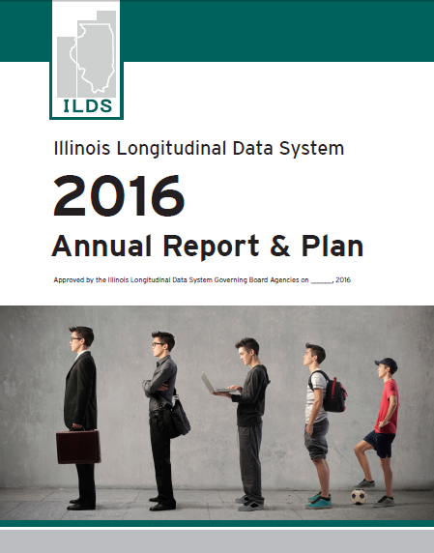
Active ILDS Governing Board Since 2013
Quarterly meetings with interagency leadership
Annual plans to establish priorities for action
Delegation to agency staff to carry out priorities
illinoislds.org

Slide 4
Data in the news!

Slide 5
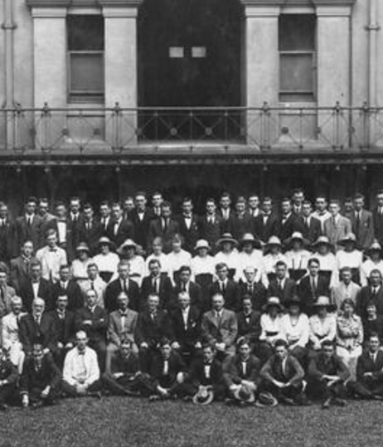
Privacy Protection
ILDS must fully comply with all state and federal law
Only aggregate analysis and reporting – never used to track an individual’s progress
Highest technological and process safeguards

Slide 6
ILDS-related Privacy Protection Laws
Federal
Family Educational Rights and Privacy Act
Privacy Act of 1974
Health Insurance Portability and Accountability Act of 1996 (HIPAA)
The Social Security Act
Gramm-Leach-Bliley Act
Higher Education Act of 1965
State
Illinois School Students Records Act
Illinois Public Aid Code
Illinois Unemployment Insurance Act
Identity Protection Act
Data Processing Confidentiality Act
P-20 Longitudinal Education Data Systems Act

Slide 7
ILDS is not this!!!

Slide 8
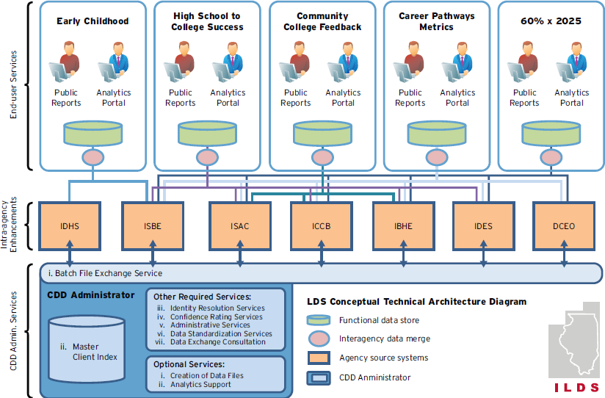
ILDS Conceptual Technical Architecture

Slide 9
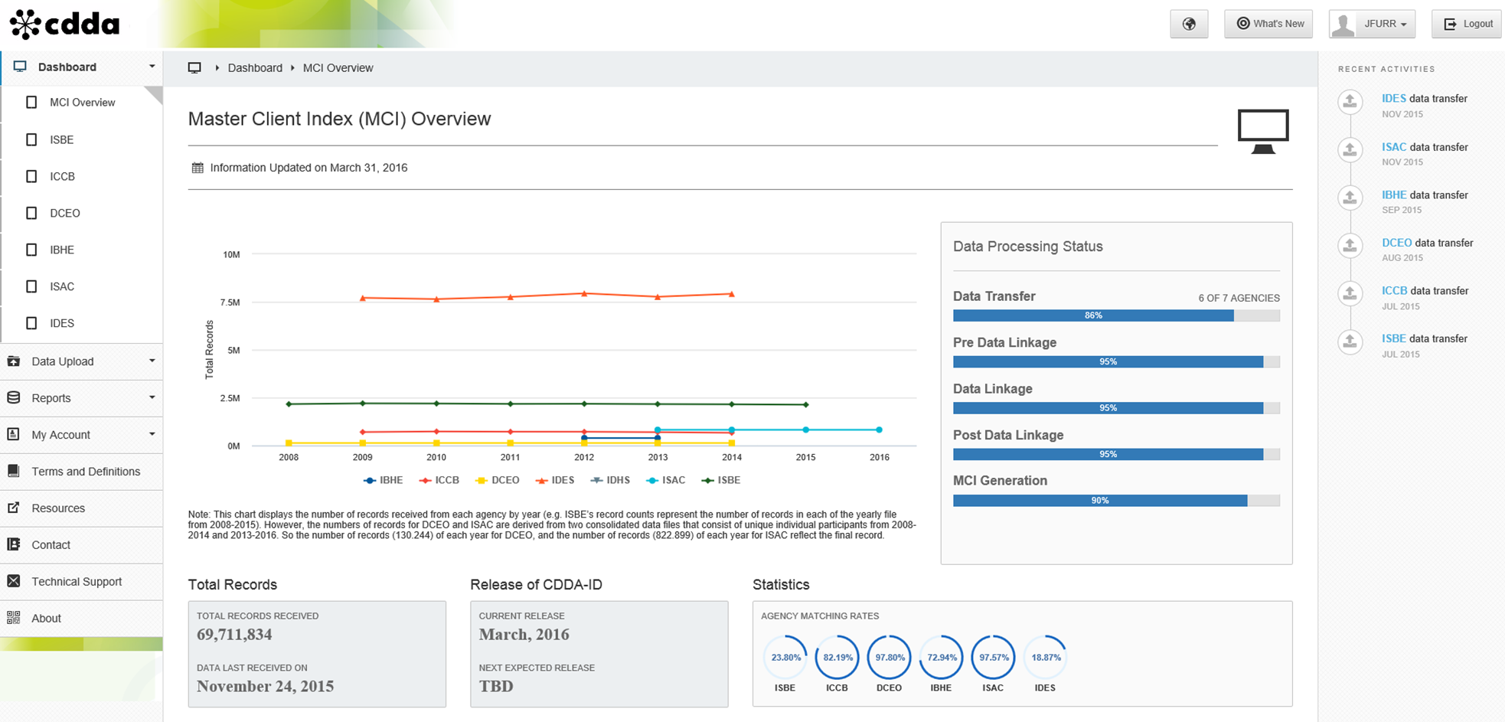

Slide 10
ILDS Conceptual Technical Architecture

Slide 11
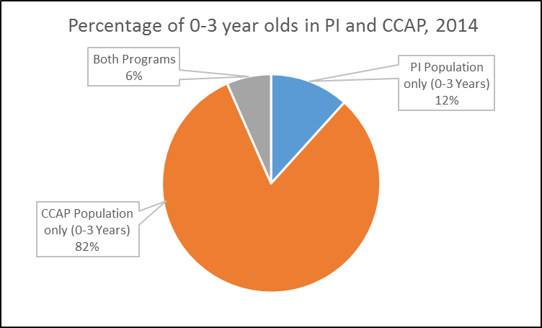
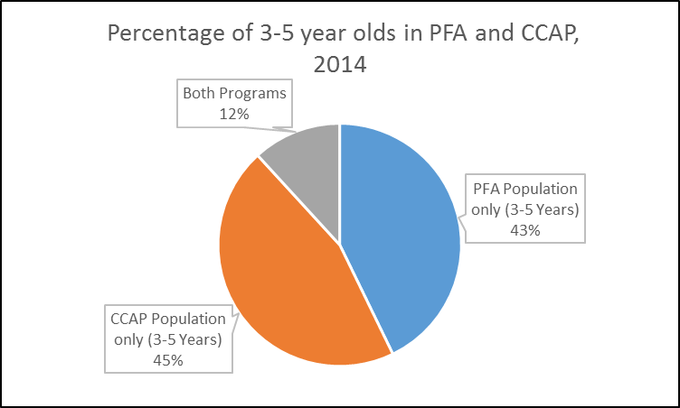
Early Childhood: ISBE and IDHS Program Unduplicated Headcount

Slide 12
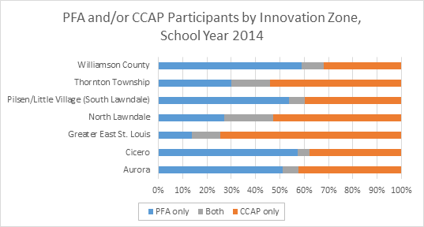
*The population is 3 to 5 year olds using Sept. 1 as the age cut-off .

Slide 13
Reporting Remedial Education Data
https://illinoisreportcard.com/

Slide 14
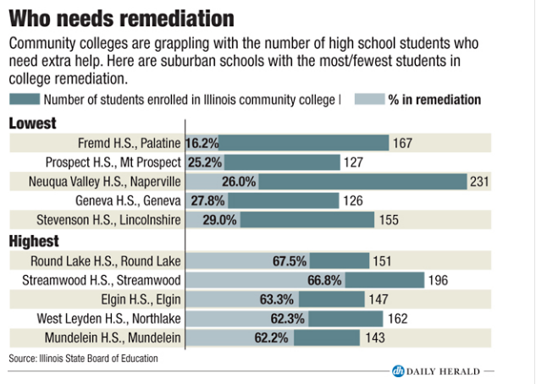
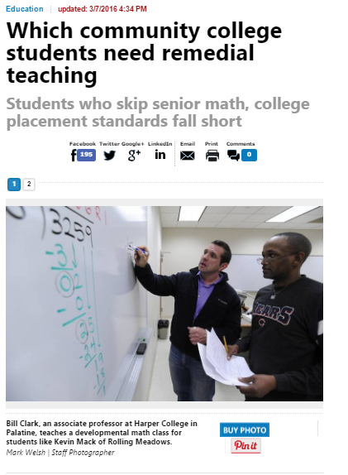

Slide 16
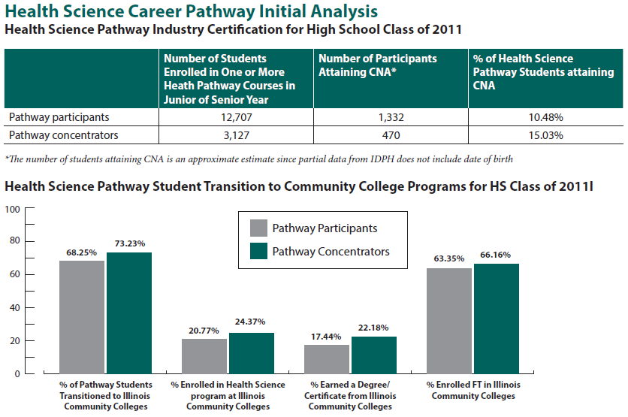

Slide 17
My State built an LDS and all my educators got was this stupid T-shirt

Slide 18
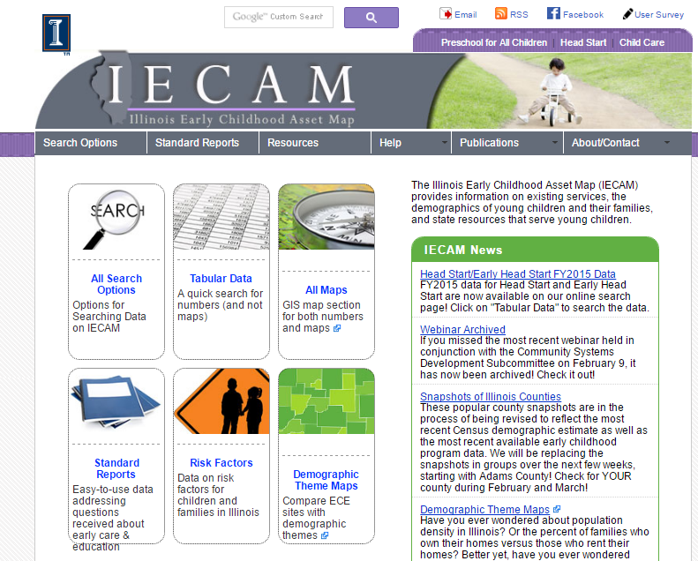
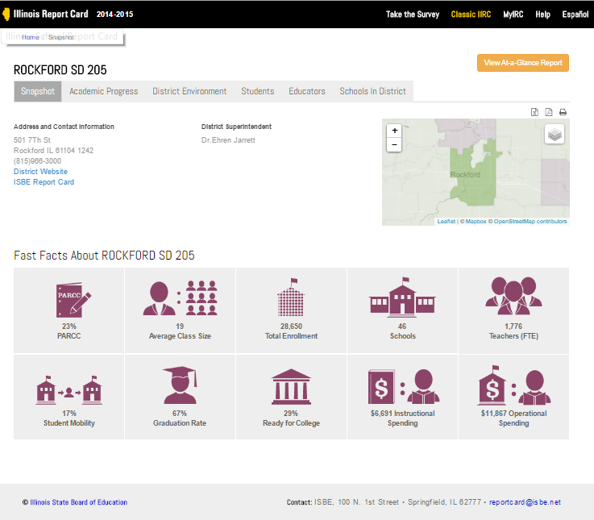

Slide 19
Statewide Longitudinal Data System Grant Program
Since 2009, ILDS-related activities have benefitted from over $20 M in funding through the federal SLDS grant program
Illinois recently received an additional $7 M through this competitive program
Focus for new grant:
Using data to better understand fiscal equity within education systems and return on investment
Delivering data for instructional support

Slide 20
How Can the ILDS Help Researchers (and vice versa)?
ILDS Governing Board developing a common process for researcher access across agencies
Common interagency data sharing agreement developed
Research agenda in early childhood
Research requests will be prioritized that align to the ILDS research agendas and priority areas
“Good luck getting the data sharing agreement through our lawyers….”

Slide 21
Thank you! Questions….
Elliot Regenstein: eregenstein@ounceofprevention.org
Jon Furr: jfurr@niu.edu

